Slide 1


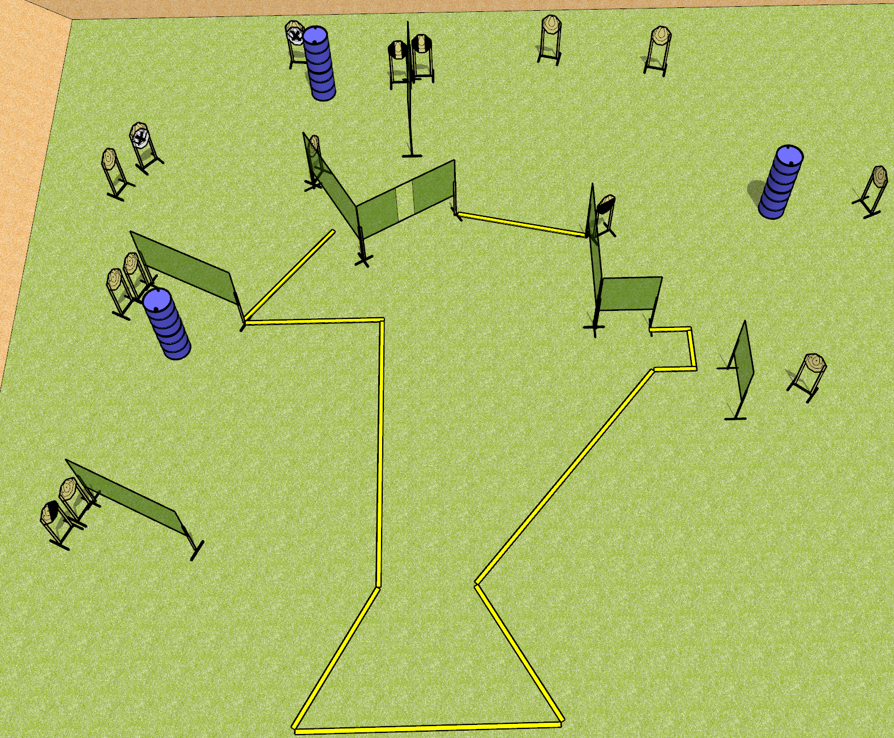
 | Dothan Gun Club – USPSA Match Two For One Course Designer : Drew Coleman Bay:
Round Count 30 rounds 15 IPSC
Equipment List 14 wall feet 3 foot fault lines for right side 1 left diag, 2 tux, 1 50% 13 targets (11 + 2 NS)

Slide 2
Two For One
Written Stage Briefing
Scoring: Comstock Rounds: 30
Targets: 15 IPSC
Handgun start position: Anywhere completely outside the shooting area, wrists below belt. Handgun is UNLOADED and holstered.
PCC start position: Anywhere completely outside the shooting area, stock on belt. UNLOADED carbine is held with both hands.
Stage Procedure: on the audible start signal, engage targets as they become available from within the shooting area.

